Slide 1
Chapter 2
Binary Number Systems

Slide 2
Symbols and their values used in positional number systems
System | Radix | Digit Symbols | Corresponding Digit Values
Binary | 2 | 0,1 | 0,1
Decimal | 10 | 0,1,2,3,4, 5,6,7,8,9 | 0,1,2,3,4, 5,6,7,8,9
Hex | 16 | 0,1,2,3,4,5,6,7, 8,9,A,B,C,D,E,F | 0,1,2,3,4,5,6,7, 8,9,10,11,12,13,14,15

Slide 3
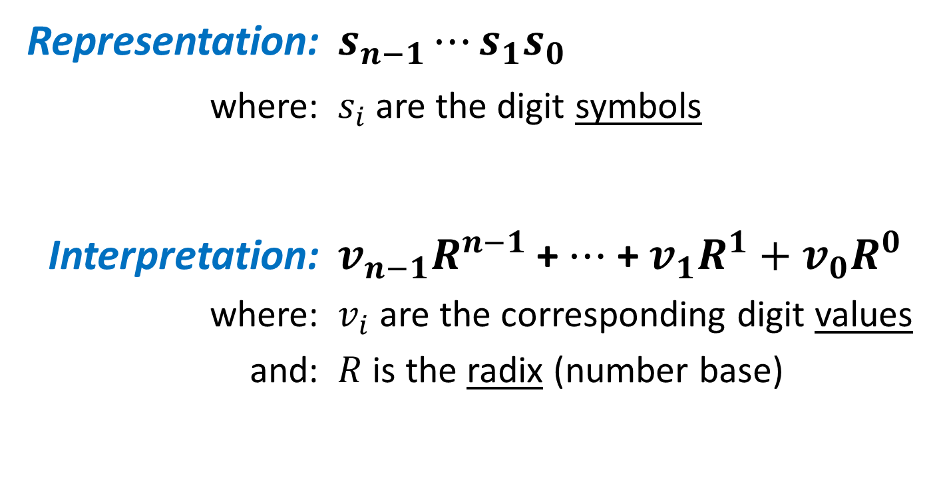
POLYNOMIAL EVALUATION
Representation: $s_{n−1}⋯s_{1}s_{0}$
where: $s_{i}$ are the digit symbols
Interpretation: $v_{n−1}R^{n−1}$ +$⋯$ + $v_{1}R^{1}+v_{0}R^{0}$
where: $v_{i}$ are the corresponding digit values
and: $R$ is the radix (number base)

Slide 4
POLYNOMIAL EVALUATION
547
Symbolic representation (What we write)
Digit values (coefficients)
= 5×10² + 4×10¹ + 7×10⁰
10
Positional weights (powers of the radix)
Subscript used to indicate the radix (number base)
= 5×100 + 4×10 + 7×1
= 500 + 40 + 7
= 547
The result of polynomial evaluation is always a decimal number, regardless of the radix used in the original representation.
Numeric interpretation
(What we understand)

Slide 5
Converting from ANY Radix to Decimal
Example: Converting from Radix 5 to Decimal
3124₅ → = 3×5³ + 1×5² + 2×5¹ + 4×5⁰
= 3×125 + 1×25 + 2×5 + 4×1
= 375 + 25 + 10 + 4
= 414₁₀
NOTE: Polynomial evaluation may be used to convert from ANY radix to decimal. The positional weights simply become powers of the radix.

Slide 6
CONVERT BINARY TO DECIMAL (Using Polynomial Evaluation)
1011₂ → = 1×2³ + 0×2² + 1×2¹ + 1×2⁰
= 1×8 + 1×2 + 1×1
= 8 + 2 + 1
= 11₁₀

Slide 7

EXTENDING POLYNOMIAL EVALUATION TO NUMBERS WITH A FRACTIONAL PART
10.010111₂ →
= 1×2¹ + 0×2⁰ + 0×2⁻¹ + 1×2⁻² + 0×2⁻³
+ 1×2⁻⁴ + 1×2⁻⁵ + 1×2⁻⁶
= 1×2¹ + 1×2⁻² + 1×2⁻⁴ + 1×2⁻⁵ + 1×2⁻⁶
= 2 + 1/4 + 1/16 + 1/32 + 1/64
= 2 + 0.25 + 0.0625 + 0.03125 + 0.015625
= 2.359375₁₀
Tedious! Four divisions and long decimal fractions!

Slide 8
AN EASIER METHOD
10.010111₂
= (1×2⁷ + 0×2⁶ + 0×2⁵ + 1×2⁴ + 0×2³
+ 1×2² + 1×2¹ + 1×2⁰)/2⁶
= (128 + 16 + 4 + 2 + 1)/64
= 151/64
= 2.359375₁₀
= 10010111₂ / 2⁶
6 fractional digits
Only a single division!

Slide 9
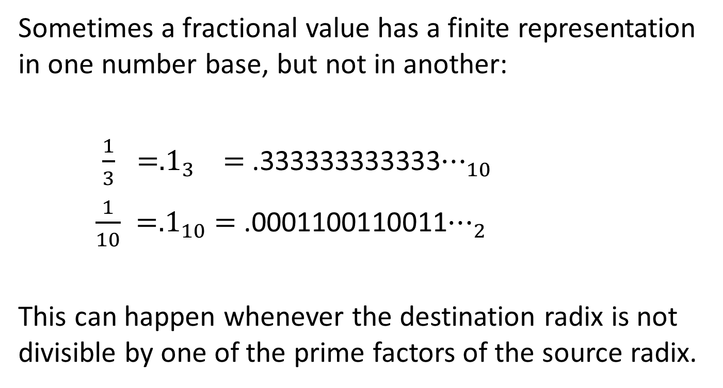
Converting Fractions
Sometimes a fractional value has a finite representation in one number base, but not in another:
$\frac{1}{3} ={.1}_{3}$ $=$ .333333333333$⋯_{10}$
$\frac{1}{10} ={.1}_{10}$ $=$ .0001100110011$⋯_{2}$
This can happen whenever the destination radix is not divisible by one of the prime factors of the source radix.

Slide 10
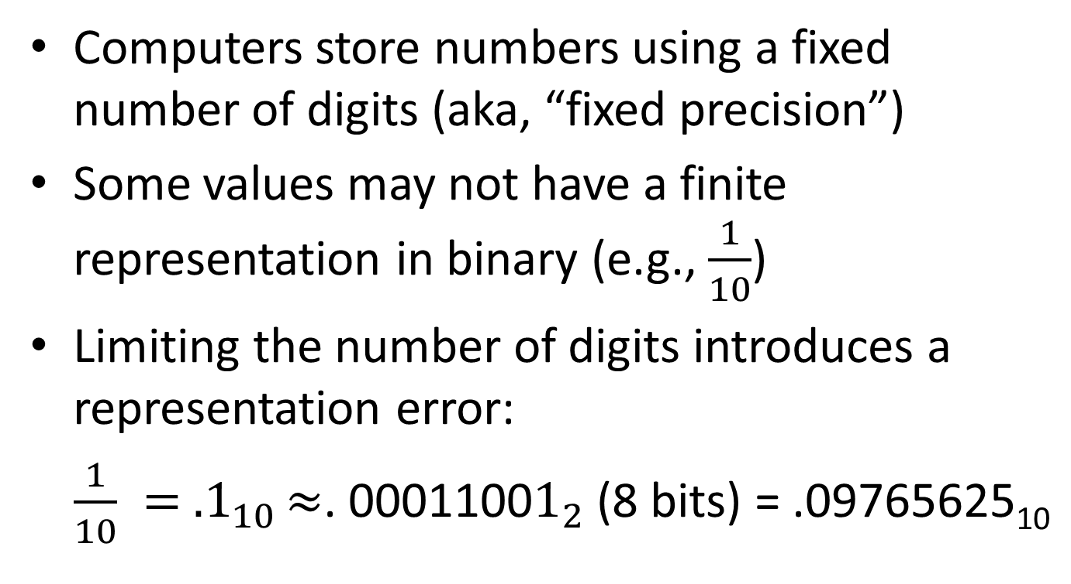
Representation Error
Computers store numbers using a fixed number of digits (aka, “fixed precision”)
Some values may not have a finite representation in binary (e.g., $\frac{1}{10}$)
Limiting the number of digits introduces a representation error:
$\frac{1}{10} = {.1}_{10}≈$. 0001100$1_{2}$ (8 bits) = .09765625₁₀

Slide 11
CONVERTING DECIMAL TO BINARY
Method 1: Separate problem into two parts:
Integer Part: Use repeated division
Fractional Part: Use repeated multiplication
Method 2: Decompose the decimal number into a corresponding sum of powers of 2.

Slide 12
CONVERTING DECIMAL TO BINARY Method 1: Integer Part (Repeated Division)
N N÷2 Remainder Result
13 6 1
6 3 0
3 1 1
1 0 1
1.
01.
101.
1101.
Digits are produced right-to-left starting from the radix point.
STOP
NOTE: Repeated division may be used to convert from decimal to ANY radix. Simply divide by the radix.

Slide 13
CONVERTING DECIMAL TO BINARY Method 1: Fractional Part (Repeated Multiplication)
Product Whole Fractional
N (2×N) Part Part Result
.1 0.2 0 .2 .0
.2 0.4 0 .4 .00
.4 0.8 0 .8 .000
.8 1.6 1 .6 .0001
.6 1.2 1 .2 .00011
Digits are produced left-to-right starting from the radix point.
Begins to repeat!
NOTE: Repeated multiplication may be used to convert from decimal to ANY radix. Simply multiply by the radix.

Slide 14
CONVERTING DECIMAL TO BINARY Method 2: Decomposition
k | 2^{k}
6 | 64
5 | 32
4 | 16
3 | 8
2 | 4
1 | 2
0 | 1
-1 | .5
-2 | .25
-3 | .125
-4 | .0625
Convert 75.3₁₀ to Binary:
Whole Part:
75 = 64 + 8 + 2 + 1
= 1001011₂
Fractional Part (approximation):
.3 = .25 + .0625
= .0101₂

Slide 15
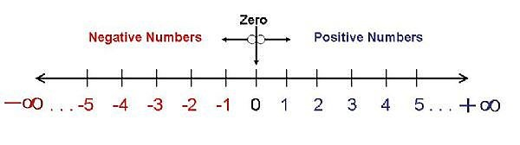
INFINITE PRECISION
Placing an infinite number of values on the number line requires a representation that imposes no limit on the number of digits.
Incrementing any number always moves to the right, producing a result that is always greater than the previous.

Slide 16
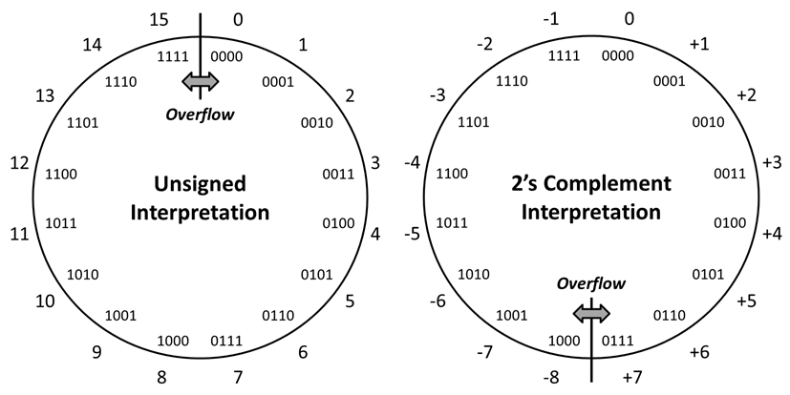
THE EFFECT OF FIXED PRECISION (Using a number circle instead of a line)
Labels inside the circle are symbolic representations.
Fixed Precision
Fixed # of digits
Finite # of values
min and max limits
max
min
=
Wrap Around
Labels outside the circle are the corresponding numeric interpretations.
Overflow: Occurs when an arithmetic result is beyond the min or max limits.

Slide 17
TWO’S COMPLEMENT REPRESENTATION OF SIGNED BINARY INTEGERS
There are several possible ways to represent signed binary numbers.
Two’s complement is the most common.
Most-Significant Bit: 0 if positive, 1 if negative.
Wrap Around
Negative Values: Not simply a 1 followed by magnitude bits.
min
max
Overflow: No longer occurs between 0000 and 1111.

Slide 18
Changing the Sign of a Two’s Complement Number (Method 1)
If +20₁₀ = 00010100₂
Then -20₁₀ = ????????₂
Change every bit: 00010100
11101011
Then add 1: +1 11101100
Simply changing the most-significant bit is NOT the same and doesn’t work!
. . .
Consider what happens when the starting value is a full-scale negative value, such as -128₁₀ = 10000000₂

Slide 19
Changing the Sign of a Two’s Complement Number (Method 2)
If +20₁₀ = 00010100₂
Then -20₁₀ = ????????₂
Copy right-to-left 00010100
through first 1:
Copy opposite of all remaining bits:
. . .
. . .
11101
100

Slide 20
CONVERTING SIGNED DECIMAL TO TWO’S COMPLEMENT
Positive values:
Convert as if unsigned
Zero extend (add 0’s on the left) to fill out the representation to the desired number of bits
Note: Most-significant bit must be 0
Negative values:
Find corresponding positive representation as above
Find the "2’s complement" of the result.

Slide 21
CONVERTING SIGNED DECIMAL TO TWO’S COMPLEMENT
Example: Find the 8-bit 2’s complement representation of -25₁₀
Convert the magnitude to unsigned binary:
25₁₀ = 16 + 8 + 1 → 11001₂
Zero extend to 8 bits:
11001 →00011001
Find the 2’s complement:
00011001 → 11100111₂

Slide 22
CONVERTING TWO’S COMPLEMENT TO SIGNED DECIMAL
Method 1:
Positive values (most-significant bit is 0)
Same as unsigned (use polynomial evaluation)
Negative values (most-significant bit is 1)
Use Two’s Complement procedure to find the representation of the corresponding positive value.
Find decimal magnitude using polynomial evaluation
Add a leading minus sign

Slide 23
Converting Two’s Complement to Signed Decimal (Method 1)
Original 2’s complement number: 10001100₂
Negative → find positive equivalent: 01110100₂
Polynomial evaluation:
64+32+16+4 = 116₁₀
Add a leading minus sign:
−116₁₀

Slide 24
CONVERTING TWO’S COMPLEMENT TO SIGNED DECIMAL
Method 2:
Use polynomial evaluation, but make the weight of the most-significant bit position negative.

Slide 25
Converting Two’s Complement to Signed Decimal (Method 2)
Original 2’s complement number: 10001100₂
Polynomial evaluation: −128+8+4
= −116₁₀

Slide 26
HEX AS A SHORTHAND FOR BINARY
Hexadecimal (radix 16) numbers require far fewer digits than their equivalent binary (radix 2) representation.
Conversion between binary and hex is trivial due to power relationship (16 = 2⁴). Each hex digit corresponds to a group of four binary digits. Groups are independent of each other.
Hex is used as a convenient short-hand for binary that reduces transcription errors.

Slide 27
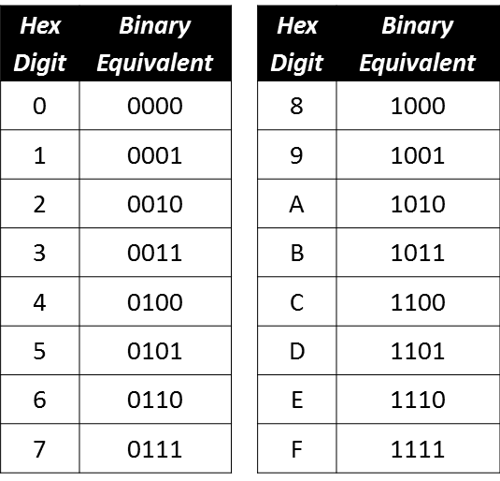
Hex/Binary Table

Slide 28
Convert Hex to Binary
Convert F1.2C₁₆ to Binary:
F 1 . 2 C
1111 0001 . 0010 1100₂

Slide 29
Convert Binary to Hex
Original binary number: 1011010.1001011₂
Split into groups of 4, starting at radix point:
101 1010 . 1001 011
Pad with 0’s to complete the groups:
0101 1010 . 1001 0110
3. Replace each group by equivalent hex digit:
5 A . 9 6₁₆
Be sure to form groups working outward from the radix point!

Slide 30
Converting from Octal to Hex
Hard way:
Convert octal to decimal using polynomial evaluation
Convert decimal to hex using repeated division/multiplication
Easy way:
Convert from octal to binary using short-cut (8 = 2³)
Convert from binary to hex using short-cut (16 = 2⁴)

Slide 31


Converting -25.75₁₀ to 2’s Comp.
-25: 25 = 16 + 8 + 1
→ 011001
-25 = 100111
.75: .75 = .5 + .25
→ .11
Combining results:
→ 100111.11₂
Checking (poly eval):
= -24.25₁₀
Correct Method:
+25.75 = 16 + 8 + 1 + .5 + .25
= 011001.11₂
Remove the binary point:
→ 01100111
Find the negative representation:
→ 10011001₂ (-103₁₀)
Restore the binary point:
→ 100110.01 (-103/4 = -25.75₁₀)

Slide 32
Review Problems
Unsigned:
Convert 110101.010101₂ to hex (base 16)
Convert unsigned FA.CE₁₆ to base 8
Convert unsigned 784₉ to base 3
Convert unsigned 25₆ to decimal
Convert unsigned 25₁₀ to base 7
Signed:
Convert -75.75₁₀ to signed 2’s complement
Convert 1001.0110₂ from 2’s comp. to decimal

Slide 33
Convert 110101.010101₂ to Hex
Use power relationship (16 = 2⁴)
Form groups of 4 bits, starting at radix point:
0011 0101 . 0101 0100
0011 0101 . 0101 0100
Use Table to convert each group:
0011 0101 . 0101 0100
3 5 . 5 4₁₆
Hex | Binary | Hex | Binary
0 | 0000 | 8 | 1000
1 | 0001 | 9 | 1001
2 | 0010 | A | 1010
3 | 0011 | B | 1011
4 | 0100 | C | 1100
5 | 0101 | D | 1101
6 | 0110 | E | 1110
7 | 0111 | F | 1111

Slide 34
Convert FA.CE₁₆ to base 8
1st: Base 16 to base 2 (16=2⁴)
2nd: Base 2 to base 8 (8=2³)
F A . C E₁₆
1111 1010 . 1100 1110₂
11111010.11001110₂
11111010.11001110₂
011 111 010 110 011 100
011 111 010 110 011 100
3 7 2 6 3 4₈
.
.
.

Slide 35
Convert 784₉ to base 3
Use power relationship (9 = 3²)
Each base 9 digit corresponds to 2 base 3 digits
Use table to convert each digit:
7 8 4₉
21 22 11₃
Base 9 | Base 3
0 | 00
1 | 01
2 | 02
3 | 10
4 | 11
5 | 12
6 | 20
7 | 21
8 | 22

Slide 36
Convert unsigned 25₆ to decimal
Base R to Decimal → polynomial evaluation:
25₆ = 2x6¹ + 5x6⁰
= 2x6 + 5x1
= 12 + 5
= 17₁₀

Slide 37
Convert unsigned 25₁₀ to base 7
Whole #₁₀ to Base R → repeated division (by 7):
25÷7 → Q=3, R=4 3
2 → Q=0, R=3
4₇
3÷7
34₇
STOP

Slide 38
Convert -75.75₁₀ to 2’s complement
1st: Get Binary Magnitude
2nd: Convert to 2’s Complement
75₁₀ = 64 + 8 + 2 + 1
= 2⁶ + 2³ + 2¹ + 2⁰
= 1001011₂
.75₁₀ = .5 + .25
= 2⁻¹ + 2⁻²
= .11₂
75.75₁₀ = 1001011.11₂
+75.75₁₀ = 01001011.11₂
Find ─75.75₁₀:
Ignore “.”: 0100101111
2’s Comp: 1011010001
Restore “.”: 10110100.01
The minimum number of bits is 10.

Slide 39
Convert 2’s Comp. 1001.0110₂ to decimal
Method #1
Method #2
1001.0110 (< 0) - Find pos. equiv:
Ignore “.” 10010110
2’s Comp: 01101010
Restore “.” 0110.1010
Get decimal = 4+2+.5+.125
= 6.625₁₀
Add minus sign -6.625₁₀
Use poly. eval. w/neg. 1st term:
1001.0110:
= -8 + 1 + .25 + .125
= -7 + .375
= -6.625₁₀

